Slide 1
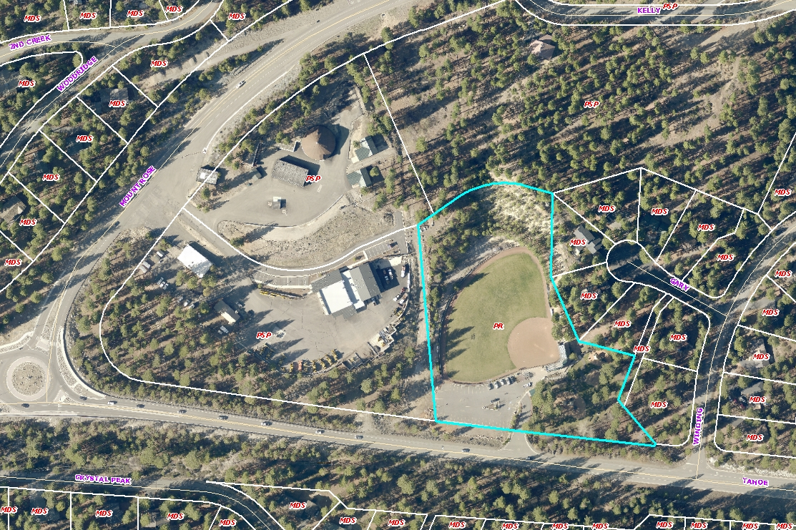
WADMIN17-0002
Incline Fine Arts Festival
Friday, August 11 to Sunday August 13, 2017
700 Tahoe Boulevard
Preston Field

Slide 2
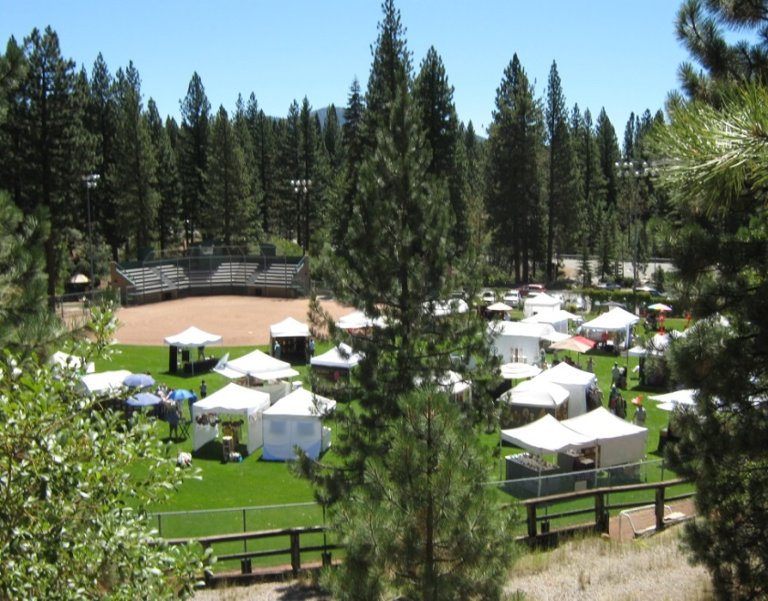
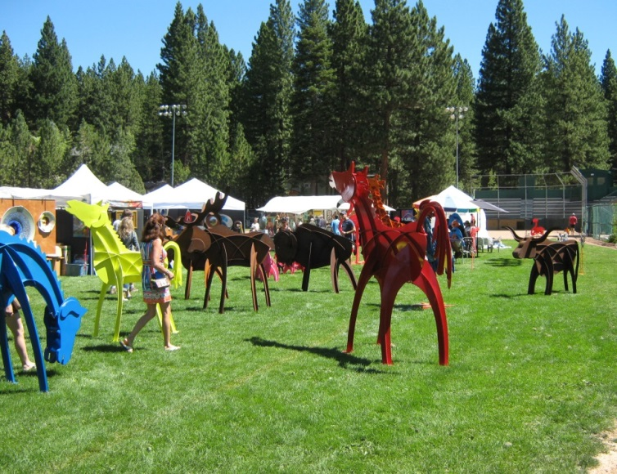
WADMIN17-0002
Fourth year of event
40 vendors
One food truck per day
Approximately 900 people per day
No amplified sound
No lighting
2014 Incline Arts Festival at Preston Field

Slide 3
WADMIN17-0002
Parking and Traffic Plan
NDOT permits
Attendance counts

Slide 4
WADMIN17-0002
I move that after giving reasoned consideration to the information contained in the staff report, information received during the public hearing, and subject to the conditions contained as Attachment A in the staff report, the Board of Adjustment approve Administrative Permit Case Number AP15-007 for the Incline Village Fine Art Festival, having made all four findings in accordance with Washoe County Development Code Section 110.808.25:
1. Consistency
Improvements
Site Suitability
Issuance Not Detrimental

